Slide 1



Festive Attendance Alliance
Making Attendance Everyone’s Business

Slide 2
Summarising our work
In year one (2022 – 2023 ) we developed the Theory of Change and galvanised support and secured a shared commitment to work together.
We defined the problem and the sustained outcomes we wanted to collectively achieve.
A website was created to capture the full breadth of our work Home page
In year two (2023 – 2024) we agreed the solutions we wanted to explore further and learn together from, gaining pledges and commitments from partners to work together on these.
To date 342 people have been engaged at least once, with 835 engagement incidences
A special thanks to our MAEB Partners, to Anglo American for funding our work and to Alan Graver of Skyblue Research who has been instrumental in driving our work forward, supporting and challenging us.

Slide 3
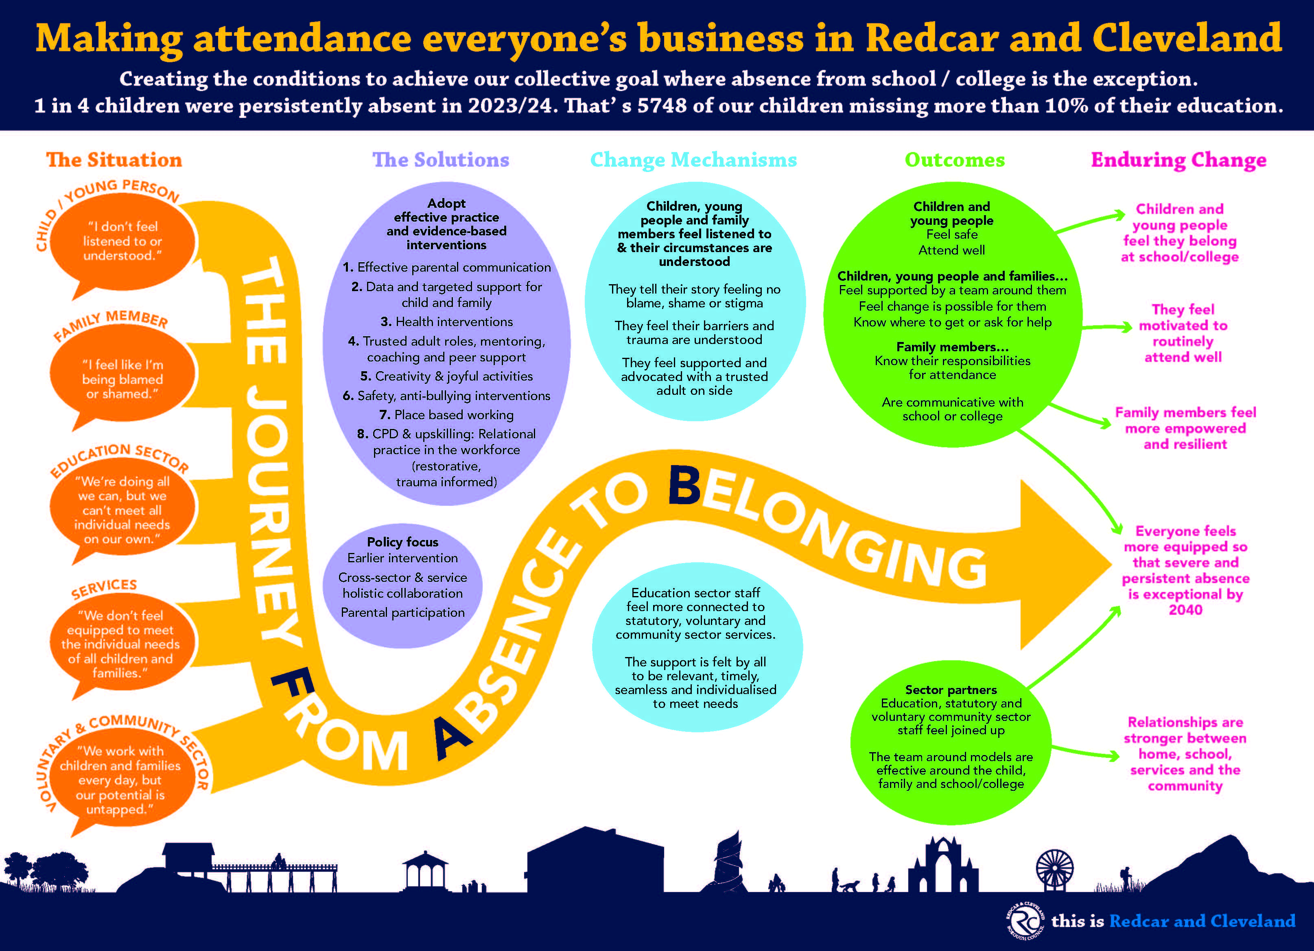
Theory of Change

Slide 4

What has happened in a year
‘Partner Connect’ event in December 2024 & two further Attendance Alliance Meetings
Development of ‘Framework for Positive Action’ and the formation of our Co-leadership Groups
Embedding the DfE statutory guidance – ‘Working Together to Improve School Attendance’ and Termly Support Meetings
Expansion of RISE Attendance and Behaviour (A&B) Hubs Programme
sign up via this form.
Two letters from the Secretary of State for Education
Development of Attendance Handbook
Collaborative work around Transition
Input into The Centre for Social Justice report – ‘Absent Ambition’

Slide 5

Why this is still so important
Although attendance is an improving picture, severe absence has increased slightly
Some groups of children and young people are disproportionately impacted
We want children and young people to get the most out of their education and learning and enjoy their experience of school/college/training
School is the best place for our children with benefits to their health, wellbeing, social interactions (building friendships) and to improve their prospects and life chances
Children and young people are safer in school and college and for our most vulnerable young people, education is a protective factor where their needs can be identified and supported
We are ambitious for our children and young people and want them to succeed!

Slide 6
MAEB – Framework for Positive Action
This Strategic ‘Framework for Positive Action’ describes the journey we want to take in Redcar and Cleveland from the baseline situation for attendance in 2023 to its desired future state by 2030.
A high-level approach outlining how we intend to overcome challenges, leverage strengths of different partners across the system and navigate the changing landscape in the next 5 years towards achieving our longer-term goal by 2040.
It will evolve with collaboration from our partners and what we learn.
For this to succeed, everyone in the system needs to believe that change is possible.

Slide 7
Strategic Education Board (Our) Priorities
Simon White
Director of Omnis Education / former CEO of Vision Academy Learning Trust

Slide 8
Strategic Education Board
Children, Young People and Families
SEND
Poverty
Mental Health
Safeguarding

Slide 9
Thematic Solutions
Cross-cutting themes:
Relational practice
Lived experience, parent/carer engagement and communications
Mentoring, peer support and coaching solutions
Targeted support and caseload management solutions
Health and attendance
Place-based approaches
Creativity, cultural and joyful interventions

Slide 10
Co-Leadership
Members of the Redcar & Cleveland Attendance Alliance (You today)
Strategically themed co-leadership action groups (individual action plans)
MAEB Co-Leadership Action Group (ensuring connectivity between individual action plans)
RCBC Leadership
Education
Statutory services
Voluntary & community sector
Lived experience

Slide 11


Health
Who are we | Why | What have we done
Wendy Kelly – South Tees Public Health Richard Gerard – South Tees Public Health Ruth Fox– Footprints in the Community | Barriers around diagnosis and treatment of pupil health conditions needs to be understood Schools need to have access to the right support Health, education and the community need to work together and align services Parents need advice and guidance about when to keep C&YP at home and when they should be in school | Launched the HeadStart attendance pilot Launched HealthStart Promoted Heathier Together Schools Planned the role out of MECC

Slide 12








Mentoring/Peer Support & Coaching
Who are we | Why | What have we done
Liz Edwards – Founder and CEO of Rubies Charity Andy Appleyard – Programme Officer, HeadStart Katie Cowie – Programme Manager, Bridges Outcomes Partnership (Turning Tides) | Ensuring all children and young people have access to a trusted adult (mentors and coaches) in schools/colleges Expand reach of peer support models to help improve transition to secondary school Build a research base that proves wellbeing support increases attendance | 10 Secondary schools benefitted from group work targeted at improving outcomes for girls Primary school pupils benefitted from peer transition support and HAF summer activities 28 secondary schools/colleges have benefitted from trusted adults improving pupils' wellbeing

Slide 13

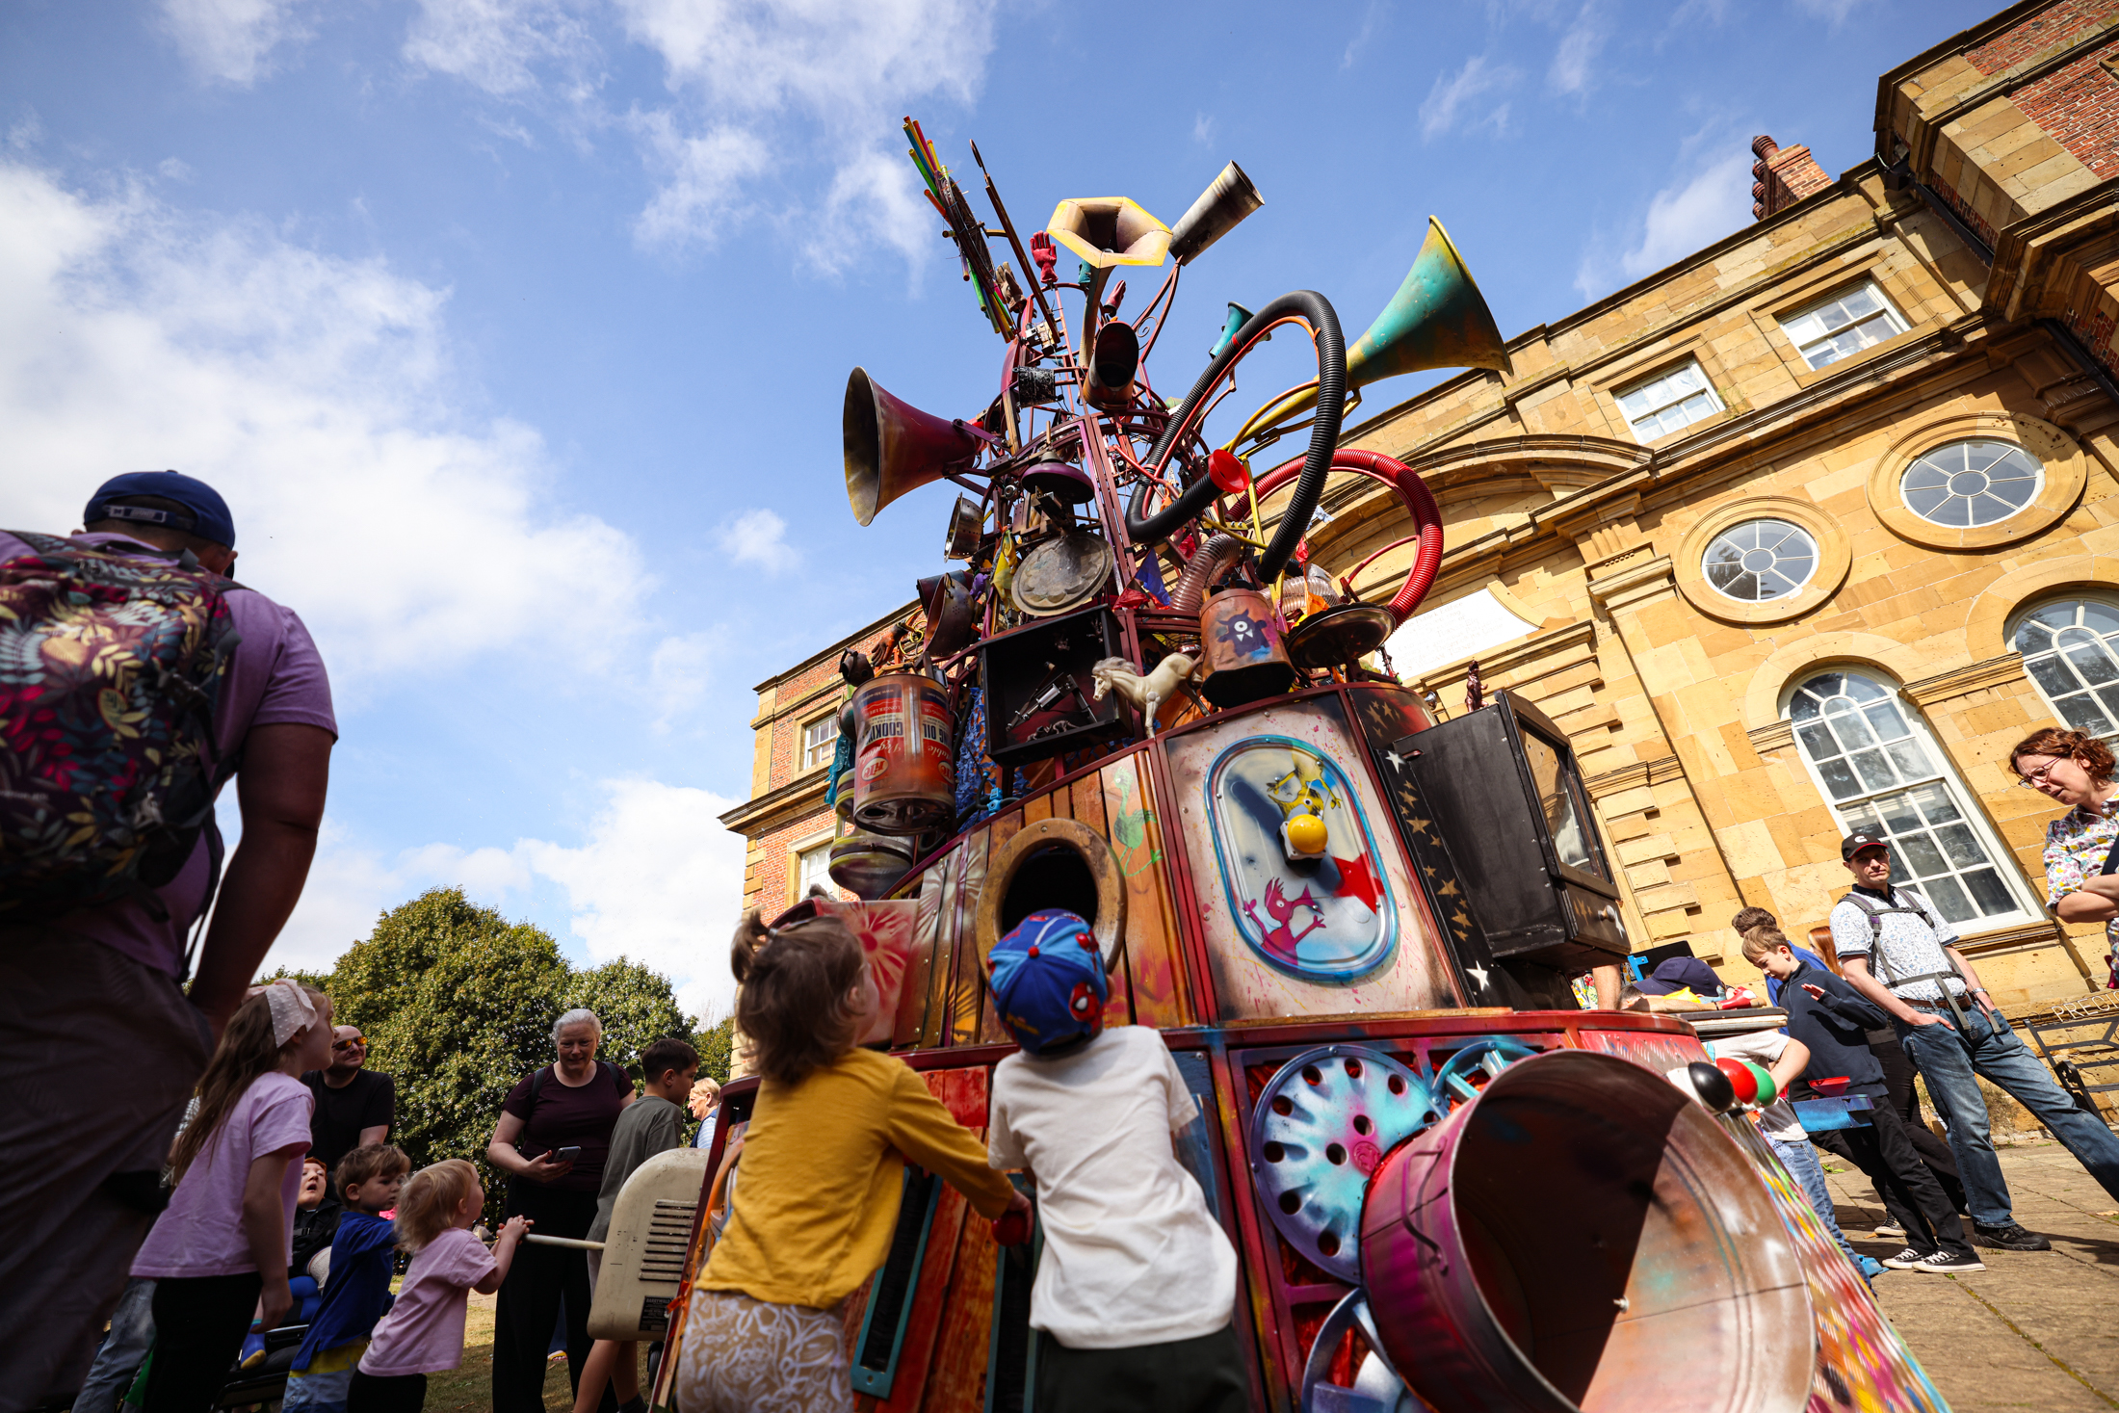
Creativity, cultural and joyful interventions
Who are we | Why | What have we done
Jacqui Hutchinson – Building Our Future (RCVDA) Lisa Storey – Cultural Development and Programmes Manager | Positive engagement and a sense of belonging can be fostered through innovative and joyful practices, creating stronger relationships between students and teachers Ensuring the voice of children and young people are heard through Student Cultural Councils to create engaging enrichment opportunities Students look forward to enjoyable clubs and activities, which increases their presence and improves overall attendance. | Learning from Enhanced Enrichment activities delivered to 55 children through the Achieve Programme Raised awareness & aspirations to 10,500 children through Building Our Future

Slide 14


Targeted Support/Caseload Management
Who are we | Why | What have we done
Nicola Hall - Early Help Jenny Li - Youth Justice Phil Dolphin - The Junction Grant Smith - Inclusion Team Elizabeth Phillips - St Peter’s Catholic College | To ensure the right package of support is offered to every child to support excellent attendance That the right staff can identify the team around the family to provide this support Early identification of pupils and families is made to prevent escalation | Action 1: Targeted Support Triage Meeting Action 2: Upskilling key staff to lead My Family Plan/Review of current practice Action 3: Using attendance data to support transition at Key Stage 2/3

Slide 15

Lived experience, parent/carer engagement
Who we are | Why | What have we done
Stacey Coates – Assistant Headteacher Caedmon Primary School Emma Hebb – Chair SEND Family Voice, Parent and Carer Forum Nicola Hunt – HeadStart Team Leader Lisa Johnson – Attendance and Welfare Officer, Steel River Academy Helen Kennedy – Community Connector Woodsmith Foundation | Parents feel genuinely listened to and respected in conversations around attendance and supported when experiencing issues Redesigning school to home communication that is easy to read and accessible and helps to build partnership rather than pressure Providing tools and support networks to parents and carers at the earliest opportunity to provide the most benefit and impact | Action 1 – Focus on quality communications and language used by schools to engage effectively with parents and carers Produced a simple quick guide for schools and professionals to adopt. This should provide parents and carers with an auto response and decrease additional emails or phone calls Action 2 – Promotion of the Local Offer and support services for parents and carers Produced a simple quick guide with links and QR Codes to the Local Offer and SEND Family Voice, Parent and Carer Forum, Redcar and Cleveland

Slide 16
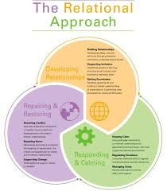
Relational Practice
Who are we | Why | What have we done
Amanda Olvanhill – Head of Attendance Jennifer Stewart – Virtual School Rachel Glover – Mo Mowlam Academy Mandy Davis – Service Manager - Children’s Practice and Innovations | A sense of belonging is a basic human need. We all need to feel safe and cared for Some children, young people and families told us that they don’t feel they belong at their school/college Children & young people are more likely to thrive, do well and enjoy learning, when schools/colleges have relationships at their core Positive teacher student relationships have been shown to be central to the wellbeing of both students and teachers | Gathered lived experience of children, young people and families to see what had helped to improve their attendance Explored good practice within the Borough and other local authorities & looked at the impact this was having Continued to embed Relational Practice model across R&C Children and Families Service. Met with Newcastle and Devon County Councils to explore how they have embedded Relational Practice across their schools

Slide 17
Thematic Discussions: Help us with the next stage of our work
Break out session 1 (2.50pm – 3:30pm)
Break out session 2 (3:35pm – 4:15pm)
Health – Bewley (H1 first session) and (H2 second session)
Targeted Response – New Bank (T1 first session) and (T2 second session)
Parental Communication, Engagement & Lived Experience – Lowther (P1 first session) and (P2 second session)
Mentoring, Coaching and Peer Support – Auditorium (M1 first session) and (M2 second session)
Creativity, Joyful and Cultural Participation – Auditorium (C1 first session) and (C2 second session)
Relational Practice – Auditorium (R1 first session) and (R2 second session)

